Slide 1

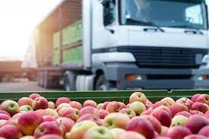
What will the apples cost?
How we built a regression model that predicts apple prices based on historical data.

Slide 2
The problem:
???
???
Suppliers don’t know how much to charge for their apples to make for the greatest profit.
They can’t ask too high, because then all their stock won’t be sold and it will decay.
They can’t charge too low, because then their income from sales will be too low.
In addition: There are factors to consider like …
The quality of the different apples.
Discounts for buying in bulk.
Should the prices be different for each province?
The time of the year? Should the prices be seasonal?
???
???

Slide 3
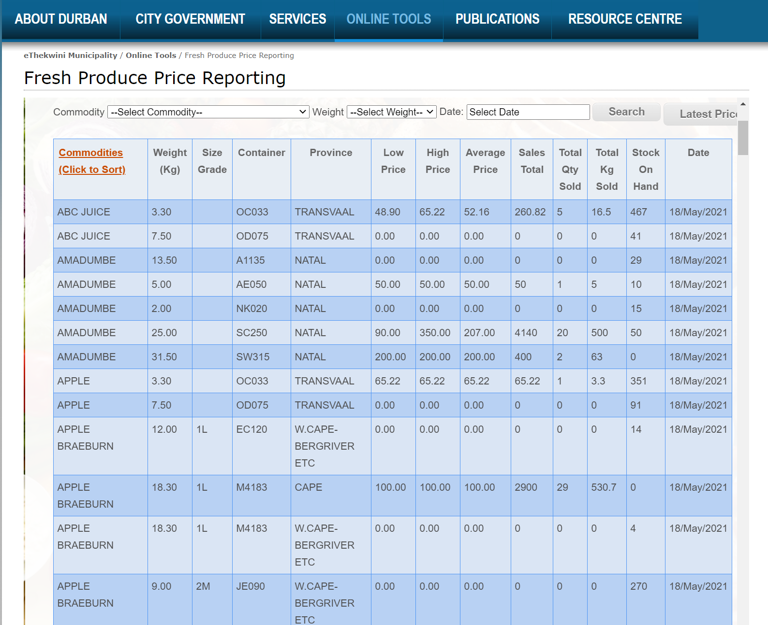
But wait … there’s data!
Durban Fresh Produce Market provided us with more than 60 000 transactions on the sales of commodities – including apples!
This data was made available for us on Kaggle in the form of a CSV file.

Slide 4

Our objective
To design a regression model that accurately predicts the cost of apples based on transactional data from Durban Fresh Produce Market.
To assess our model with a subset of the data.
To upload it onto Kaggle to compete with others to find the best model for the job.
To communicate our findings to the world so it might be implemented.

Slide 5

The team & time for the task
We have a diverse team from all walks of life.
1. Jacques Stander (group coordinator) - background in teaching
2. Khomotso Maake – background in psychology
3. Keletso Pule – background in applied math
4. Harrison Hlongwane – background in IT
5. Bhalisa Sodo – background in IT
We worked on this for 4 weeks under the supervision of Trevor Senyane.

Slide 6
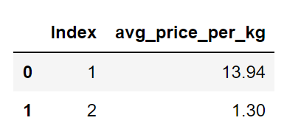
The Kaggle submission format

Slide 7

Step 1: Exploring the data [i]
We started by importing the necessary packages
pandas & numpy for data wrangling
Matplotlib & seaborn for data visualization
Statsmodels & sklearn for data modeling
We imported the CSV files into pandas DataFrames
Then we filtered it and showed only Apple Golden Delicious.

Slide 8
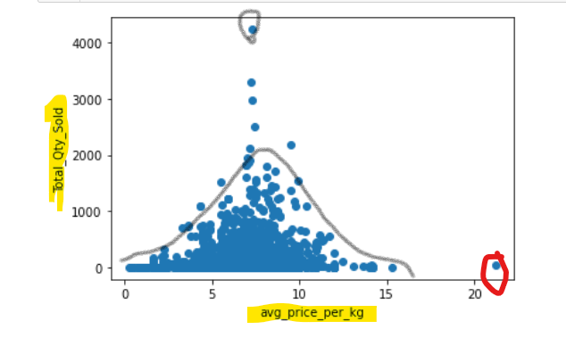
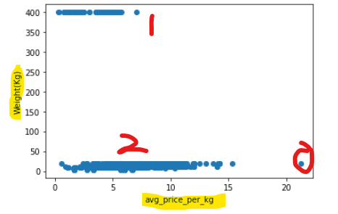
Step 1: Exploring the data [ii]
Insights from plots

Slide 9
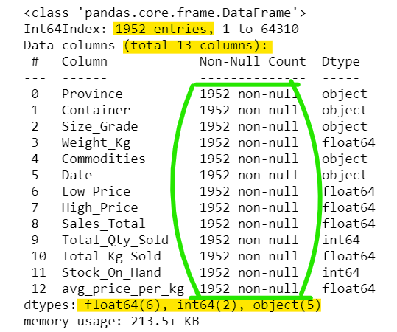
Step 1: Exploring the data [iii]
Looking for shape, data-types and null values.

Slide 10
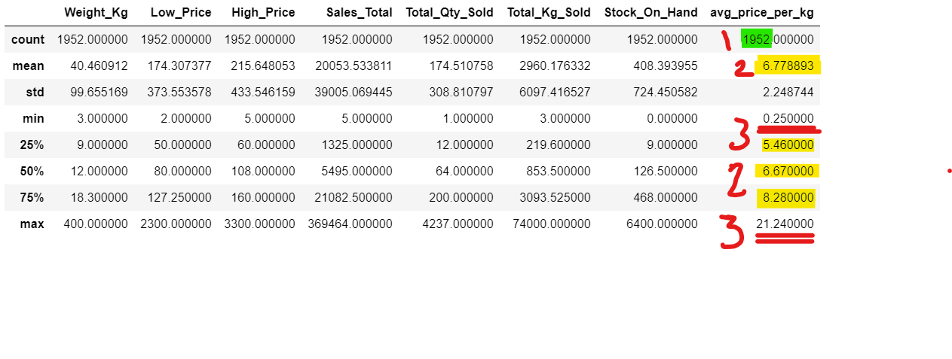
Step 1: Exploring the data [iv]

Slide 11
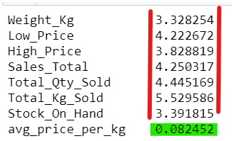
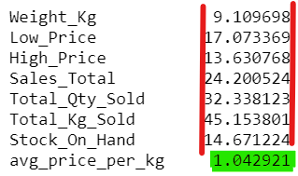
Step 1: Exploring the data [v]
Determining the skew and the kurtosis

Slide 12
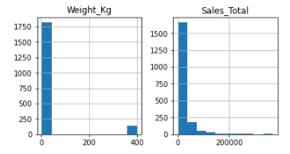
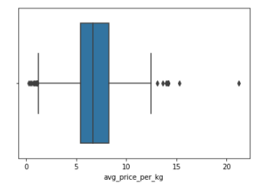
Step 1: Exploring the data [vi]
The skew and kurtosis visually …

Slide 13
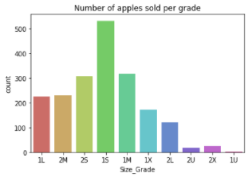
Step 1: Exploring the data [vi]
The Size Grade most often sold:

Slide 14
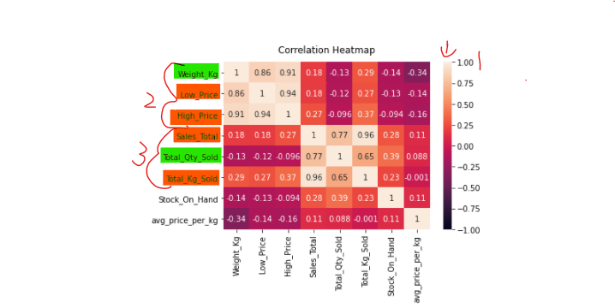
Step 1: Exploring the data [vii]
Checking for correlated values

Slide 15
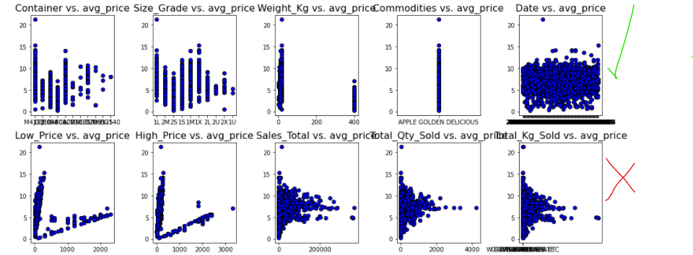
Step 1: Exploring the data [viii]
Testing for linearity (another correlation test)

Slide 16
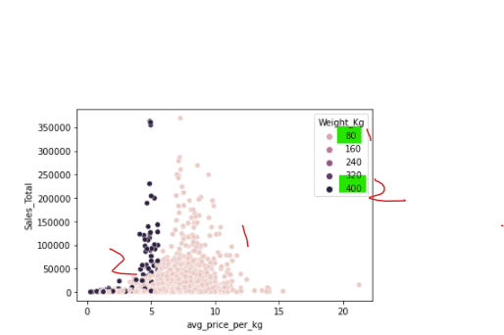
Step 1: Exploring the data [ix]
There is a discount!
… but few make use of it.

Slide 17
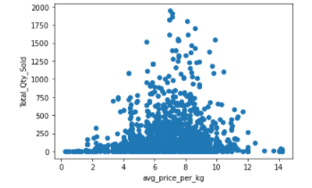
Step 2: Wrangling the data [i]
We dropped the outliers

Slide 18
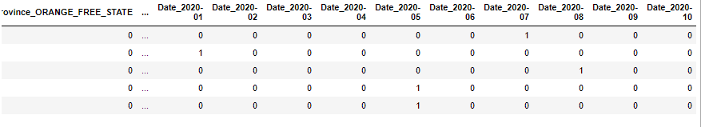
Step 2: Wrangling the data [ii]
We dropped the days in the date column.
We transformed the categorical data to numeric data.
We outputted one less column than categories to avoid correlation.
We did this for the test data as well.

Slide 19
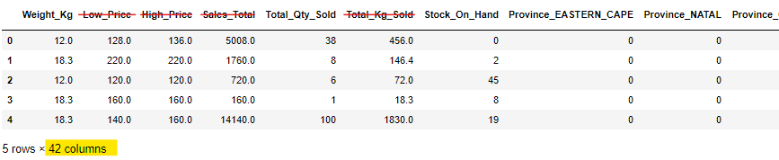
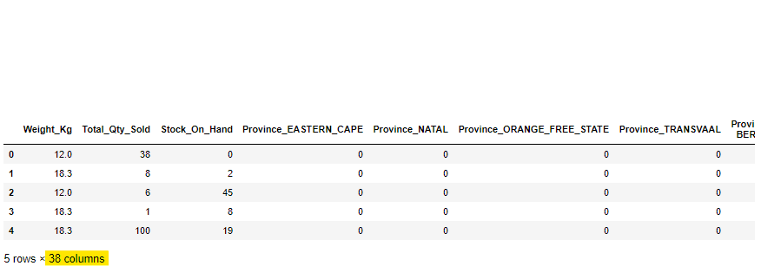
Step 2: Wrangling the data [iii]
We dropped the correlated columns
We did the same for the test data

Slide 20
Step 2: Wrangling the data [iv]
We attempted scaling the data and setting variance thresholds of 0.03 and 0.05.
But these only worsened our final predictions.
So our final models did not take it into consideration.

Slide 21
Step 3: Splitting the data
We split the data 80-20. We trained our models on the 80% and assessed the accuracy of our models on the 20%.
We did however train our model on all 100% of the data when we submitted our final model onto Kaggle in order to increase the accuracy of the model’s predictions.
80 - 20

Slide 22
Step 4: Building & training the models [i]
Model Description | Python Packages
1. Multivariate Linear Regression Model | Sklearn’s LinearRegression
2. Statsmodels model | Statsmodels
3. SVR Model | Sklearn’s SVR
4. Decision Tree Model | Sklearn’s DecisionTree Regressor
5. Voting Model | Sklearn’s VotingRegressor
6. Random Forest Model | Sklearn’s RandomForestRegressor
7. Adaboost Classifier | Sklearn’s Standard Sclaer, & BaggingRegressor

Slide 23
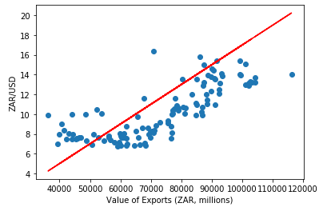
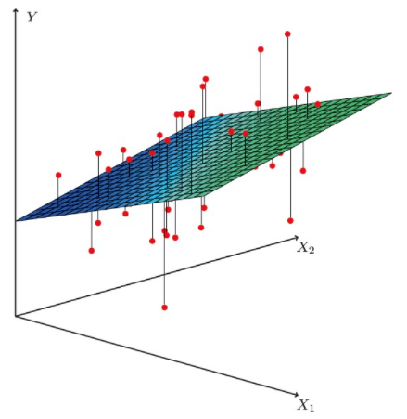
Step 4: Building & training the models [ii]
How the Linear Regression model works

Slide 24
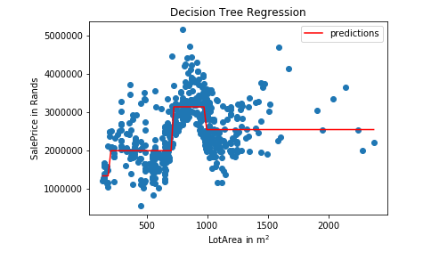
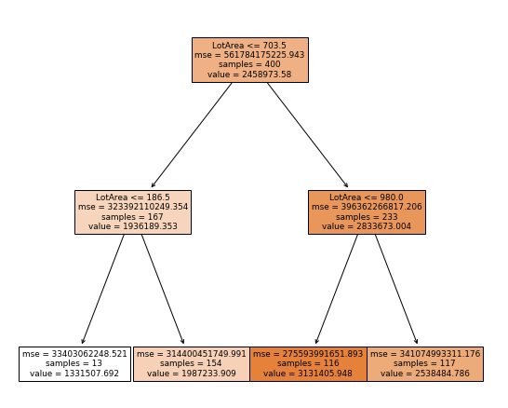
Step 4: Building & training the models [iii]
How the decision tree model works

Slide 25
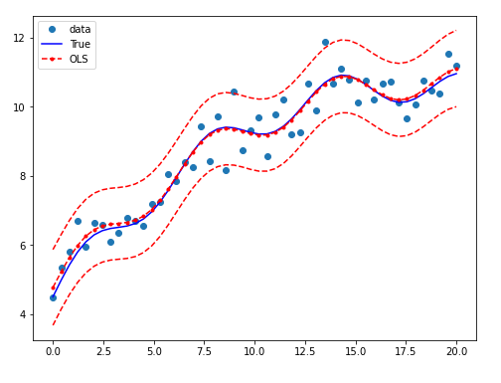
Step 4: Building & training the models [iii]
How the statsmodels model works

Slide 26
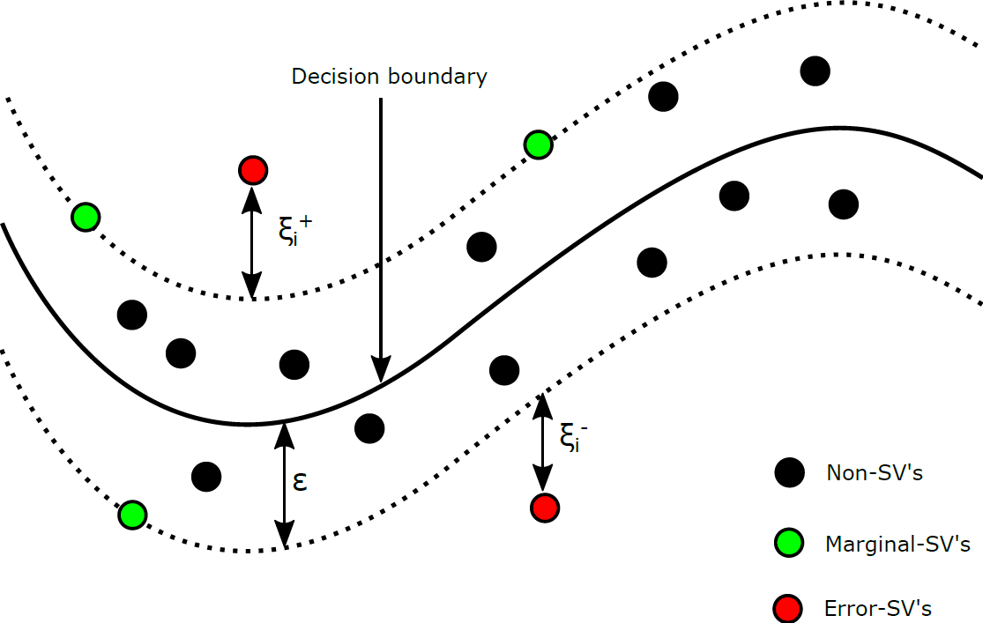
Step 4: Building & training the models [iv]
How the SVR model works

Slide 27
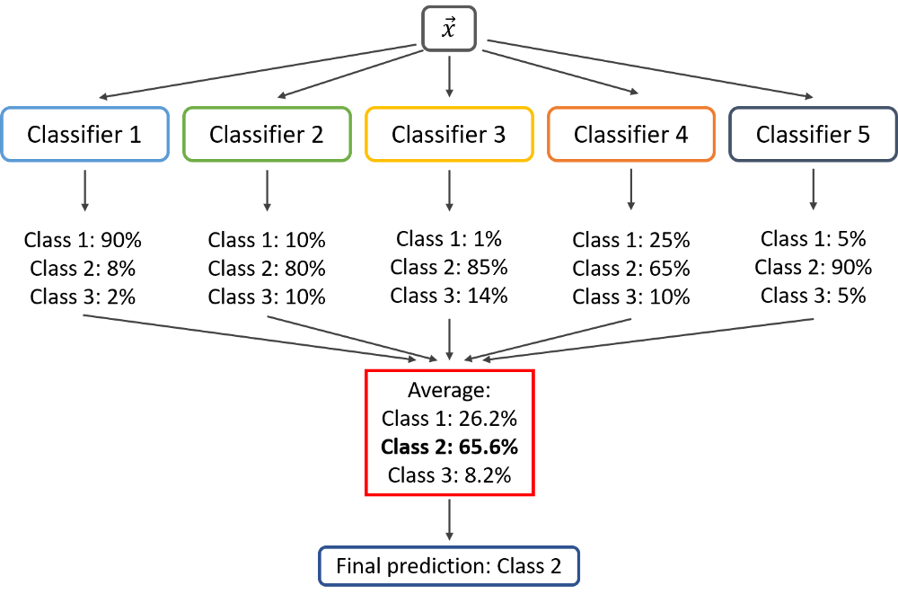
Step 4: Building & training the models [v]
How the Voting model works

Slide 28
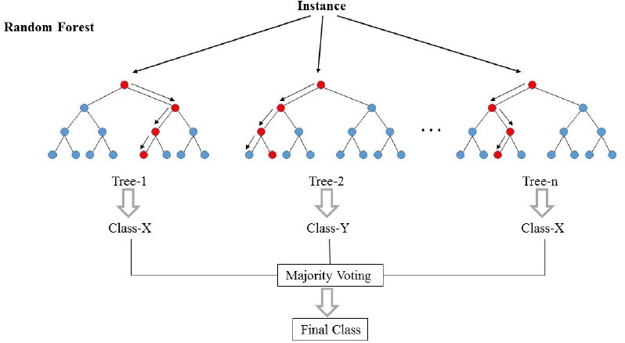
Step 4: Building & training the models [vi]
How the Random Forest model works

Slide 29
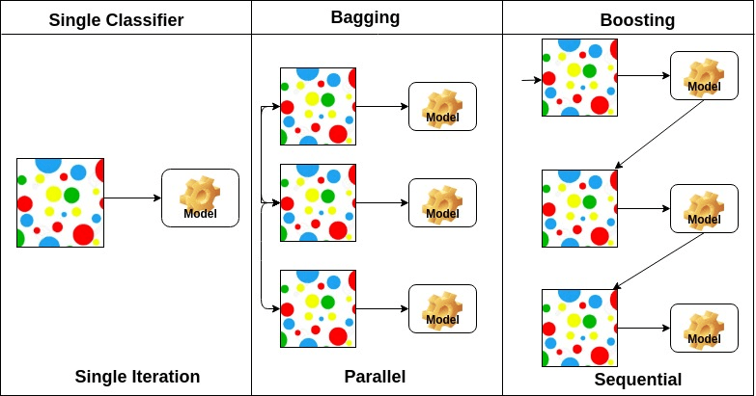
Step 4: Building & training the models [vii]
How the adaboost classifier works

Slide 30
Step 5: Assessing the models
How the models performed
Model | Internal RMSE | Kaggle RMSE
1. Multivariate Linear Regression Model | 1.36 | 1.32
2. Statsmodels model | 8.62 | Did not submit
3. SVR Model | 1.75 | 1.18
4. Decision Tree Model | 1.52 | 1.18
5. Voting Model | 1.28 | 1.29
6. Random Forests Model | 0.40 | 1.05
7. Adaboost Classifier | 1.50 | 1.36

Slide 31

Conclusion [i]
Objective: Build a regression model that accurately predicts apple prices based on data provided.
We have accomplished our goal!
Steps we took:
We explored the data
We wrangled the data
We split the data
We built & fitted our models on the data
We assessed our models

Slide 32
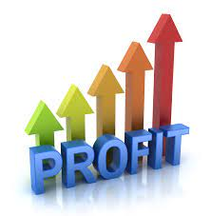
Conclusion [ii]
Results: We managed to build a model that predicts apple prices very accurately (RMSE: 0.40)
Our model placed us at position 36th on the Kaggle leaderboard with an RMSE as measured by them of 1.05.
Suppliers can now more accurately predict their competitor’s apple prices so that they can adjust their own prices and thereby maximize their profit.

Slide 33
Any questions?
Team Member Responsible: | Responsibility:
Harrison: | API, Git & Data pre-processing
Bhalisa: | AWS & Linear Regression model
Keletso: | Data Exploration, DecisionTree Model & SVR & Adaboost Model
Khomotso: | Statsmodels, Voting Model Random Forest Model
Disclaimer: None of the models or pictures used are our own, but were browsed.

